Slide 1
Introduction to Cyber Security

Slide 2
Classes of Threats
Disclosure: unauthorized access to information
Deception: acceptance of false data
Disruption: interruption or prevention of correct operation
Usurpation: unauthorized control of some part of a system

Slide 3
Threats and Attacks
Threat | Attack Scenarios
Disclosure | Exposure: Sensitive data released to an unauthorized entity. Interception: An unauthorized entity accesses sensitive data in transit Inference: An unauthorized entity indirectly accesses sensitive data by reasoning Intrusion: An unauthorized entity gains access to sensitive data by circumventing a system’s security protections.
Deception | Masquerade: An unauthorized entity gains access to a system or performs a malicious act by posing as an authorized entity. Falsification: False data deceive an authorized entity. Repudiation: An entity deceives another by falsely denying responsibility for an act.

Slide 4
Threats and Attacks
Threat | Attack Scenarios
Disruption | Incapacitation: Prevents or interrupts system operation by disabling a system component. (Disable) Corruption: Undesirably alters system operation by adversely modifying system functions or data. (Corrupt) Obstruction: A threat action that interrupts delivery of system services by hindering system operation. (Obstruct)
Usurpation | Misappropriation: An entity assumes unauthorized logical or physical control of a system resource Misuse: Causes a system component to perform a function or service that is detrimental to system security

Slide 5
Threats and Assets
 | Availability | Confidentiality | Integrity
Hardware | Equipment is stolen or disabled, thus denying service.
Software | Programs are deleted, denying access to users. | An unauthorized copy of software is made | A working program is modified to cause it to fail during execution or do some unintended task
Data | Files are deleted, denying access to users | An unauthorized read of data is performed. An analysis of statistical data reveals underlying data. | Existing files are modified or new files are fabricated.
Communication Lines | Messages are destroyed or deleted. Communication lines or networks are rendered unavailable. | Messages are read. The traffic pattern of messages is observed | Messages are modified, delayed, reordered, or duplicated. False messages are fabricated.

Slide 6
Policy and Mechanism
A security policy is a statement of what is, and what is not, allowed
A security mechanism is a method, tool, or procedure for enforcing a security policy
Security policy: What to deploy, Security mechanism: How to deploy?
Policies may be presented mathematically, as a list of allowed (secure) and disallowed (nonsecure) states
Eg: A website requires users to login to the system (policy). Users can login using a user name and password pair (mechanism). They can also login using their Gmail or Facebook accounts (another mechanism).

Slide 7
Goals of Security
Prevention means that an attack will fail.
For example, if one attempts to break into a host over the Internet and that host is not connected to the Internet, the attack has been prevented
Recovery has two forms
Stop an attack and repair any damage caused by that attack.
Eg: if the attacker deletes a file, one recovery mechanism would be to restore the file from backup tapes
System continues to function correctly while an attack is under way.
This type of recovery is quite difficult to implement because of the complexity of computer systems.

Slide 8
Assumptions and Trust
Scenario: opening a door lock requires a key.
The assumption is that the lock is secure against lock picking.
A good lock picker, however, can open a lock without a key.
Hence, in an environment with a skilled, untrustworthy lock picker, the assumption is wrong and the consequence invalid.

Slide 9
Saltzer and Schroeder’s Security Principles
Economy of Mechanism
Keep all security systems simple
Simple is not the same as small
Simple systems are easier to understand, debug and maintain
Typically less prone to errors
Fail Safe Defaults
Your default security mechanism should be “deny”
Provide access to only those people and resources that are required
False Negatives are better than False Positives
Black listing vs white listing

Slide 10
Saltzer and Schroeder’s Security Principles
Complete Mediation
Check EVERY access to EVERY object
If a program requests access to a file, the permissions must be checked every time the file is accessed, not only the first time
Open Design
Diametrically opposite to “Security by Obscurity” (security vulnerabilities remain hidden)
Publish all your security mechanisms/algorithm
Public scrutiny, early identification of defects and vulnerabilities
Open Source Software – fewer security issues
All cryptographic algorithms are in the public domain – only the keys remain secret

Slide 11
Saltzer and Schroeder’s Security Principles
Separation of Privilege
Check multiple conditions before giving access
Banking websites check username, password and OTP
One check might fail, but it is highly unlikely that multiple checks would fail
Least Privilege
Figure out which capabilities are required – grant ONLY those
Design principle behind sandboxes

Slide 12
Saltzer and Schroeder’s Security Principles
Least Common Mechanism
Mechanisms used to access resources should not be shared
Sharing resources provides a channel of communication
E.g. A web site provides Ecommerce services for a major company. Attackers want to deprive the company of the revenue they obtain from that web site. They flood the site with messages, and tie up the electronic commerce services. Legitimate customers are unable to access the web site and, as a result, take their business elsewhere.
Here, common mechanism is Internet that should not be shared.
Psychological Acceptability
Security mechanisms should be designed for ease of use
Eg: Passwords can be guessed for 25 – 80% users. But passwords still continue to be used extensively because they are easy to use

Slide 13
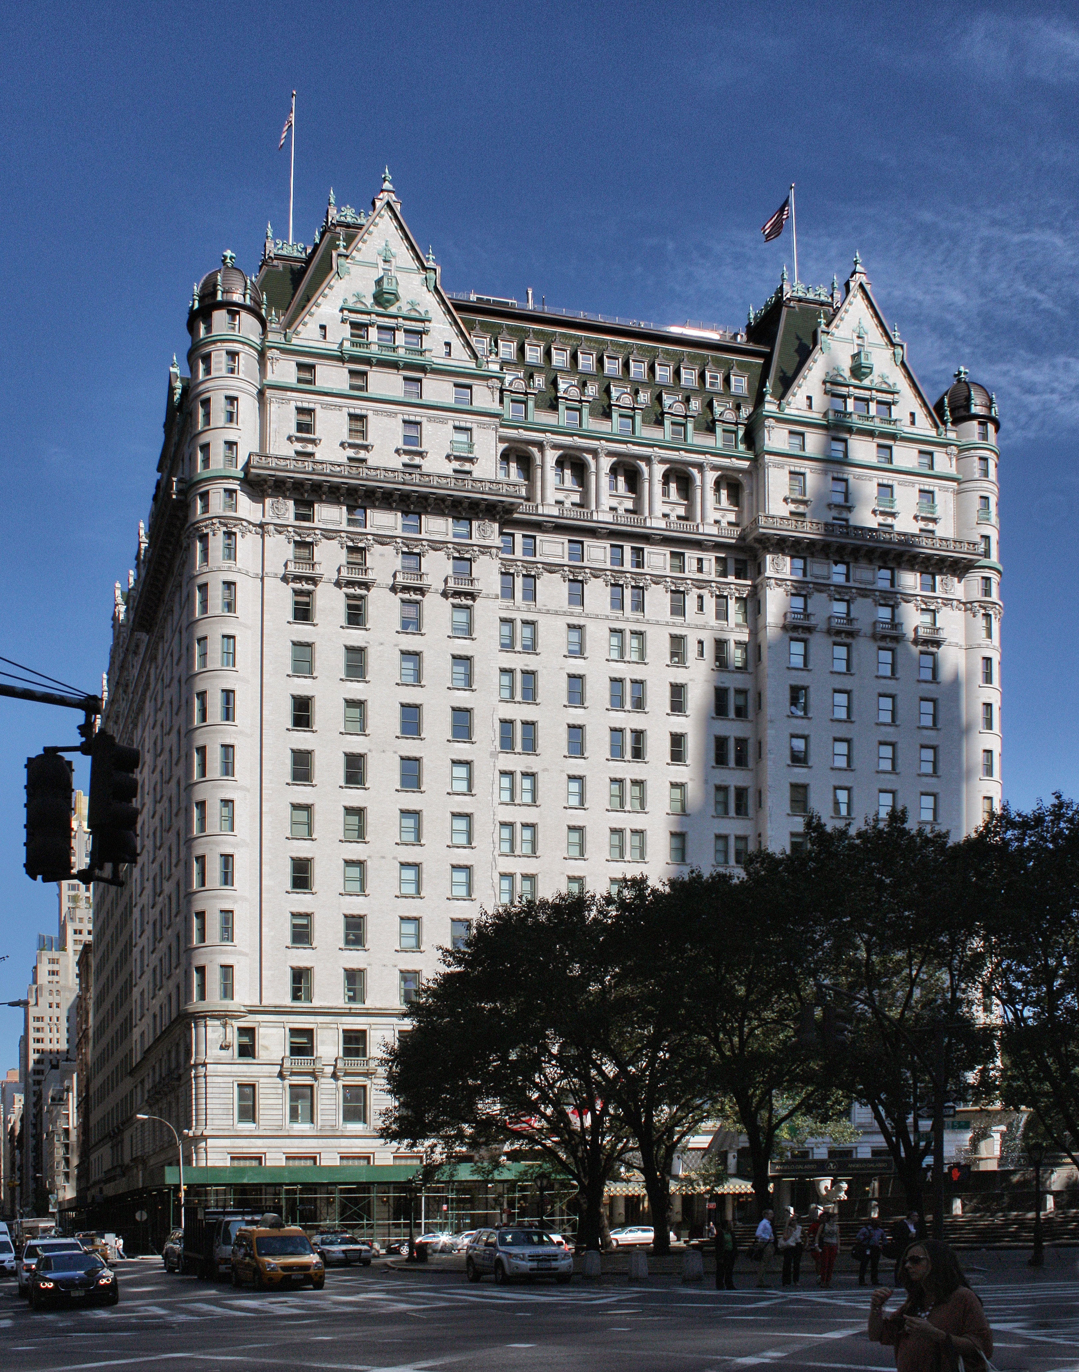
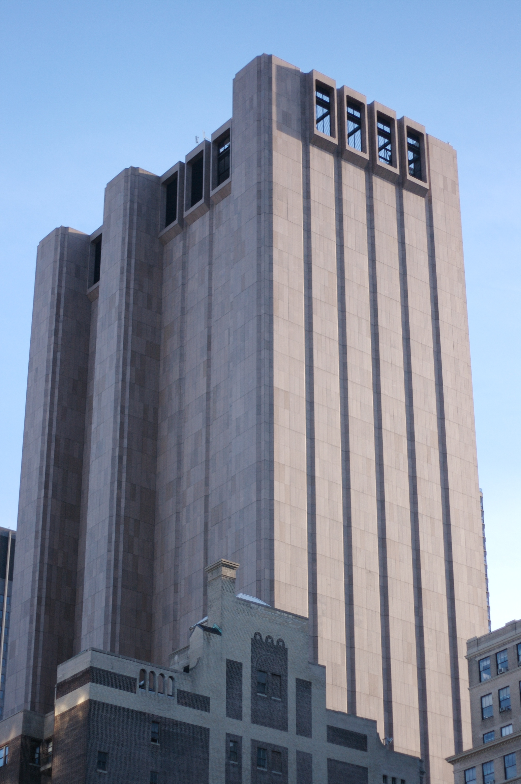
Attack Surfaces
Which of the two buildings are more easy to break into?
The Plaza Hotel
The AT&T Long Lines Building (“Building with No Windows”)

Slide 14
Attack Surfaces
Attack surface is the total number of points or vectors through which an attacker could try to enter an environment
In cybersecurity, the concept applies to ways an attacker could send data to and/or extract data from a network/software/system
Attack surfaces could be physical attack surfaces (such as hard disks, USB drives etc.) or digital attack surfaces (Eg: applications, code, ports, servers, and websites)

Slide 15
Reducing your Attack Surface
Less code, less software attack surface
Remove unnecessary OS software and services
Scan your network ports
Analyze your SSL certificates
Segment your network
Audit your software, network and traffic
Train all your employees to avoid getting tricked

Slide 16
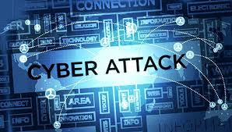
Abstract
What if large attack surface: Welcome to Cyber Attacks
A cyber attack is an attack launched from one or more computers against another computer, multiple computers or networks.
It is an attempt by hackers to damage or destroy a computer network or system.
Those who perform cyber attacks or cyber crime are called cyber criminals.

Slide 17
Abstract
Most Common Cyber Attack
Malware
Phishing
Man-in-the-middle attack
Denial-of-service attack
SQL injection
Zero-day attack

Slide 18
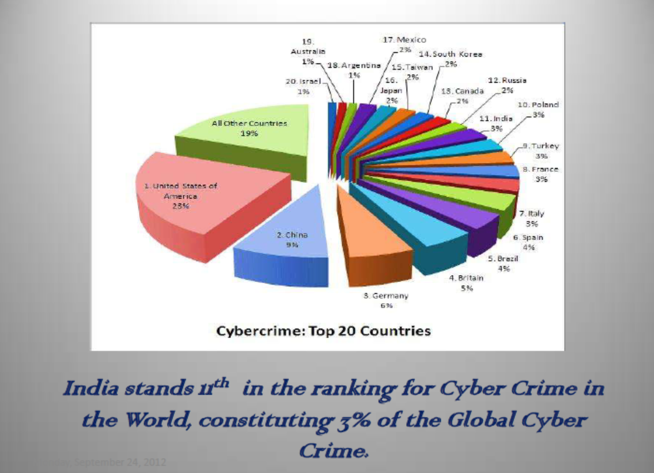
Abstract
Cyber crime statistics in India
In India
121 Million Internet Users
65 Million Active Internet Users,
50 Million users shop online on Ecommerce and Online Shopping Sites
46+ Million Social Network Users
346 million mobile users had subscribed to Data Packages.

Slide 19
Abstract
Cyber crime statistics in India
The majority of cybercrimes are centered on forgery, fraud and Phishing.
India is the third-most targeted country for Phishing attacks after the US and the UK,
Social networks as well as ecommerce sites are major targets,
15,000 sites hacked in 2011,
India is the number 1 country in the world for generating spam
29.9 million people fell victim to cybercrime,
$4 billion in direct financial losses,
$3.6 billion in time spent resolving the crime,
4 in 5 online adults (80%) have been a victim of Cybercrime,
17% of adults online have experienced cybercrime on their mobile phone.
The police have recorded 3,038 cases but made only 2,700 arrests in 3 years (between 2007 and 2010)
India registered only 1,350 cases under the IT Act and IPC in 2010
50% of cybercrimes are not even reported.

Slide 20
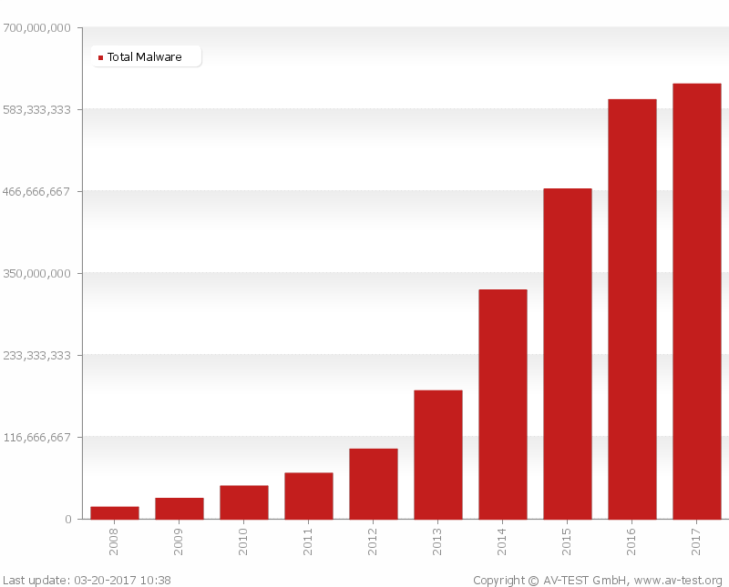
Abstract
Malware
MALWARE is
Malicious Software.
Adware, Spyware,Virus,Worm, Ransomware
Malware can
allow cybercriminals to get into other people’s computers without their permission
steal personal information
delete files
steal software serial numbers
According to AV-Test in March 2017,the total number of malwares is increasing exponentially since 2008.
Due to such increasing ,it is necessary to detect these files before they harm

Slide 21

Phishing
In a phishing attack, an attacker may send you an email that appears to be from someone you trust, like your boss or a company you do business with. The email will seem legitimate, and it will have some urgency to it (e.g. fraudulent activity has been detected on your account). In the email, there will be an attachment to open or a link to click. Upon opening the malicious attachment, you’ll thereby install malware in your computer. If you click the link, it may send you to a legitimate-looking website that asks for you to log in to access an important file—except the website is actually a trap used to capture your credentials when you try to log in.

Slide 22
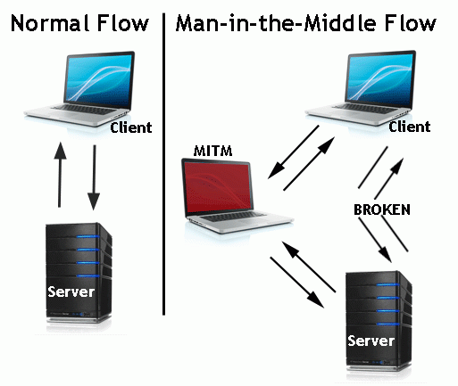
Man-in-the-middle Attack
A man-in-the-middle attack is a type of cyber attack where a malicious actor inserts him/herself into a conversation between two parties, impersonates both parties and gains access to information that the two parties were trying to send to each other. A man-in-the-middle attack allows a malicious actor to intercept, send and receive data meant for someone else, or not meant to be sent at all, without either outside party knowing until it is too late.

Slide 23
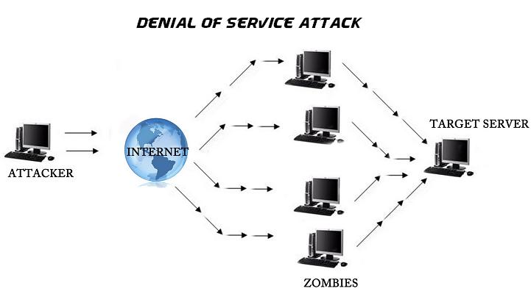
Denial-of-service Attack
A Denial of Service (DoS) attack, consists of sending a large amount of internet traffic towards a server which hosts a website to stop somebody or anybody from accessing it.
As a result, the server is unable to fulfill legitimate requests.
A distributed denial of service (DDoS) attack uses an army of computers, usually compromised by malware and under the control of cybercriminals, to funnel the traffic towards the targets.

Slide 24
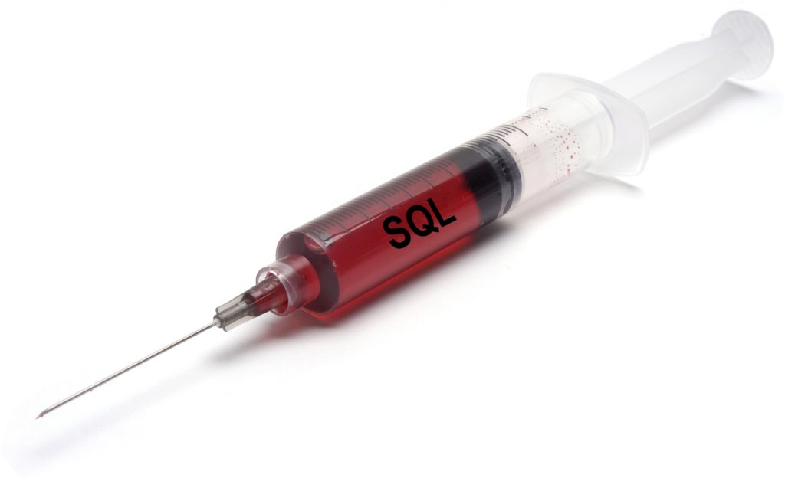
SQL Injection Attack
SQL (pronounced “sequel”) stands for structured query language; it’s a programming language used to communicate with databases.
Many databases are designed to obey commands written in the Structured Query Language (SQL), and many websites that take information from users send that data to SQL databases.
An attacker wishing to execute SQL injection manipulates a standard SQL query and forces the server that stores the database to reveal or manipulate information it normally would not.

Slide 25
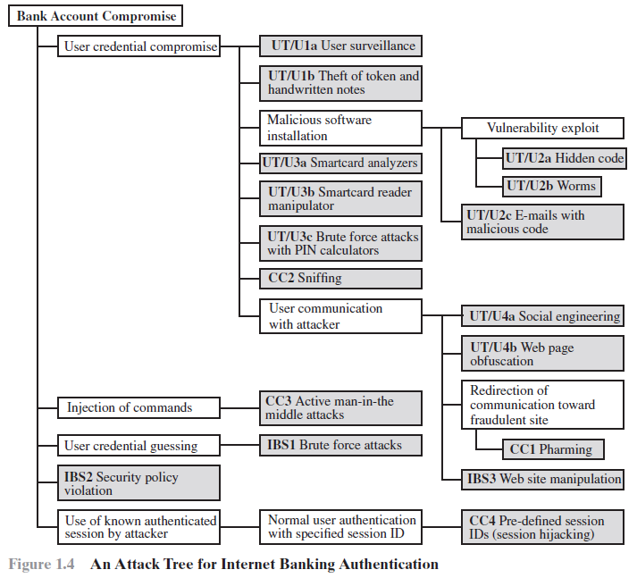
Attack Trees – A Technical Example

Slide 26
Security Functional Requirements
Access Control:
Limit information system access to authorized users
Awareness and Training:
Ensure that managers and users of organizational information systems are made aware of the security risks associated with their activities and of the applicable laws, regulation, and policies related to the security of organizational information systems
Ensure that personnel are adequately trained to carry out their assigned information security-related duties and responsibilities.
Audit and Accountability:
Auditing: Create, protect, and retain information system audit records to the extent needed to enable the analysis, investigation, and reporting of unauthorized information system activity.
Accountability: Ensure that the actions of individual information system users can be uniquely traced to those users so they can be held accountable for their actions.
Certification, Accreditation, and Security Assessments:
Periodically assess the security controls to determine if they are effective;
Develop and implement plans of action designed to correct deficiencies and reduce or eliminate vulnerabilities in organizational information systems.

Slide 27
Security Functional Requirements
Configuration Management:
Establish and maintain baseline configurations of information systems (including hardware, software, firmware, and documentation)
Establish and enforce security configuration settings for IT products.
Contingency Planning:
Establish, maintain, and implement plans for emergency response, backup operations, and post disaster recovery
Identification and Authentication:
Identify users, processes acting on behalf of users, and authenticate (or verify) their identities as a prerequisite to allowing access to organizational IT services.
Incident Response:
Establish a team that can do adequate preparation, detection, analysis, containment, recovery, and user-response activities; and
Track, document, and report incidents to appropriate organizational officials and/or authorities.

Slide 28
Security Functional Requirements
Maintenance:
Perform periodic and timely maintenance
Provide effective controls on the tools, techniques, and mechanisms used to conduct information system maintenance.
Media Protection:
Protect information system media, both paper and digital
Limit access to information on information system media to authorized users
Sanitize or destroy information system media before disposal or release for reuse.
Physical and Environmental Protection:
Limit physical access
Protect information systems against environmental hazards
Provide appropriate environmental controls in facilities containing information systems.
Planning:
Develop, document, periodically update, and implement security plans for organizational information systems.

Slide 29
Security Functional Requirements
Personnel Security:
Ensure that individuals occupying positions of responsibility within organizations (including third-party service providers) are trustworthy;
Ensure that organizational information and information systems are protected during and after personnel actions such as terminations and transfers;
Risk Assessment:
Periodically assess the risk to organizational operations
Systems and Services Acquisition:
Allocate sufficient resources to adequately protect organizational information systems;
Employ system development life cycle processes that incorporate information security considerations (DevSecOps)
Employ software usage and installation restrictions;

Slide 30
Security Functional Requirements
System and Communications Protection:
Monitor, control, and protect organizational communications at the external boundaries and key internal boundaries of the information systems
System and Information Integrity:
Identify, report, and correct information and information system flaws in a timely manner;
Provide protection from malicious code at appropriate locations within organizational information systems
Monitor information system security alerts and advisories and take appropriate actions in response.

Slide 31
Security Strategy
A comprehensive security strategy involves three aspects:
Specification/policy: What is the security scheme supposed to do?
Implementation/mechanisms: How does it do it?
Correctness/assurance: Does it really work?

Slide 32
Security Strategy
Security Policy:
Following factors to be considered:
Value of assets being protected
Vulnerabilities of the system
Potential threats and the likelihood of attacks
Other trade-offs:
Ease of use versus security
Cost of security versus cost of failure and recovery
A business decision, possibly influenced by business requirements.

Slide 33
Security Strategy
Security Implementation:
Four courses of action:
Prevention
Ideal security scheme is one that can prevent an attack
Detection
Sometimes prevention is not possible. Something is better than nothing
Response
If an ongoing attack is detected, halt it and prevent further damage.
Recovery
If data integrity is compromised, reload the correct copy of data from backup servers.

Slide 34
Security Strategy
Assurance and Evaluation:
A belief that the security measures in place work as intended.
Assurance is the degree of confidence one has that the security measures work as intended
Deals with questions:
Does the security system design meet its requirements?
Evaluation is the process of examining a computer product or system with respect to certain criteria.
Evaluation involves testing
Thrust area: Development of evaluation criteria

Slide 35
Thank you…

